Slide 1


DB CENTER
- ALI ALHAWAS (439015852)
- ABDULRAHMAN ALGHURMAN(4380009996)
- NASSER ALKHURAYJI (438011631)
- ANAS ALZHRANI (438011286)
- NAWAF ALDAHAM (4339011864)
SUPERVISED BY
SULTAN ALQAHTANI

Slide 2

OUTLINE
Introduction 3-6
Methodology 7-17
Results 14 -17
Team contribution 19
Conclusion 20

Slide 3

Introduction

Slide 4

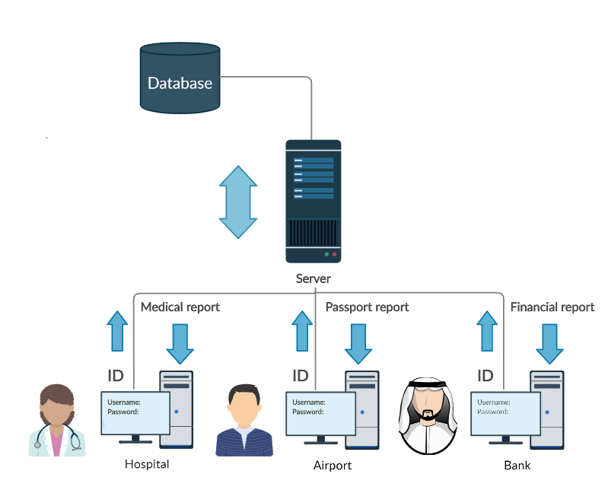
Introduction we want to Build a System that save and keep Track of all medical, financial, permanent record and Crash Reports

Slide 5

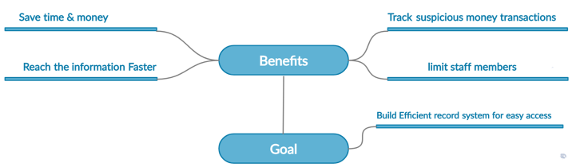
The Goal and Importance of The Project

Slide 6

Our Project Objectives - Integration - Security - Scalability

Slide 7
Methodology

Slide 8
We Have in our Project 8 FR and 4 NFR
Login Page
Search Function
Display Profile
Scalability

Slide 9
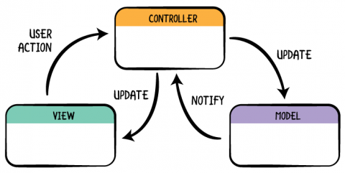
System Architecture

Slide 10
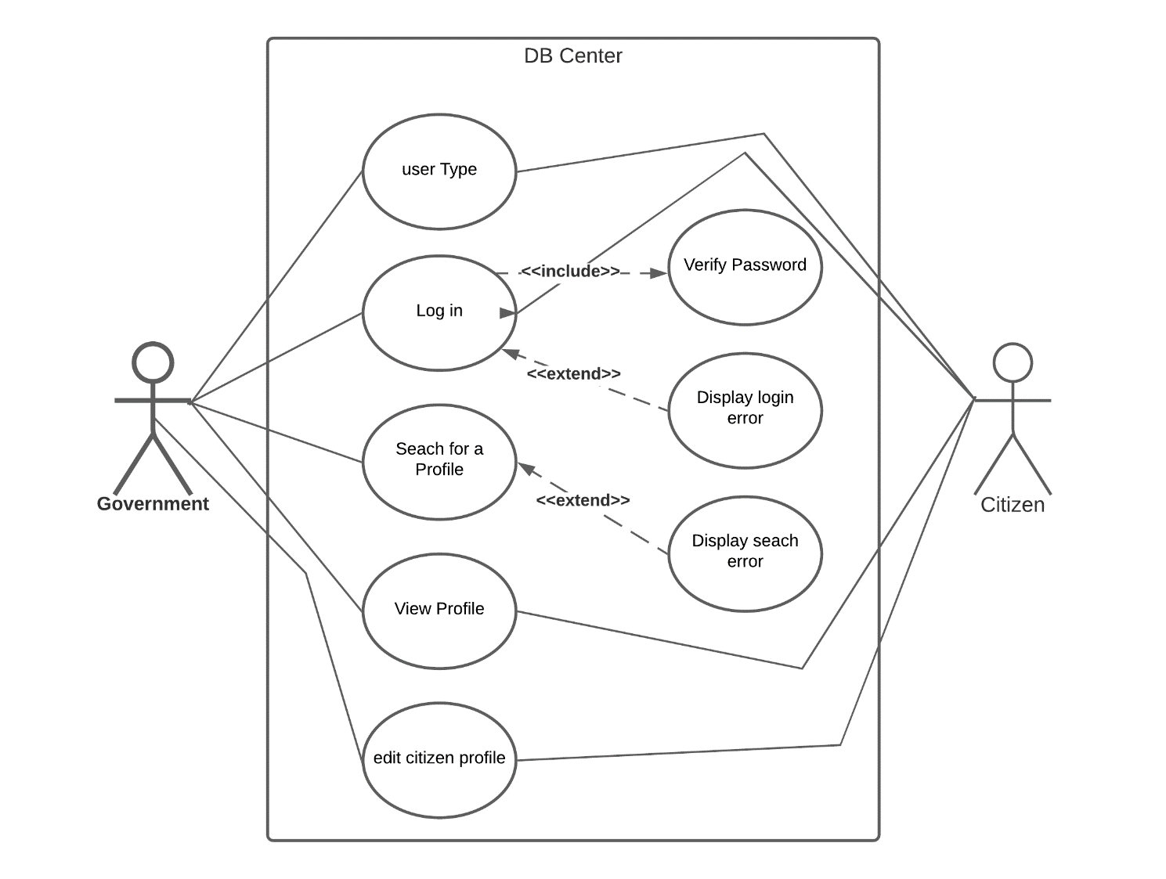
Use Case Diagram

Slide 11
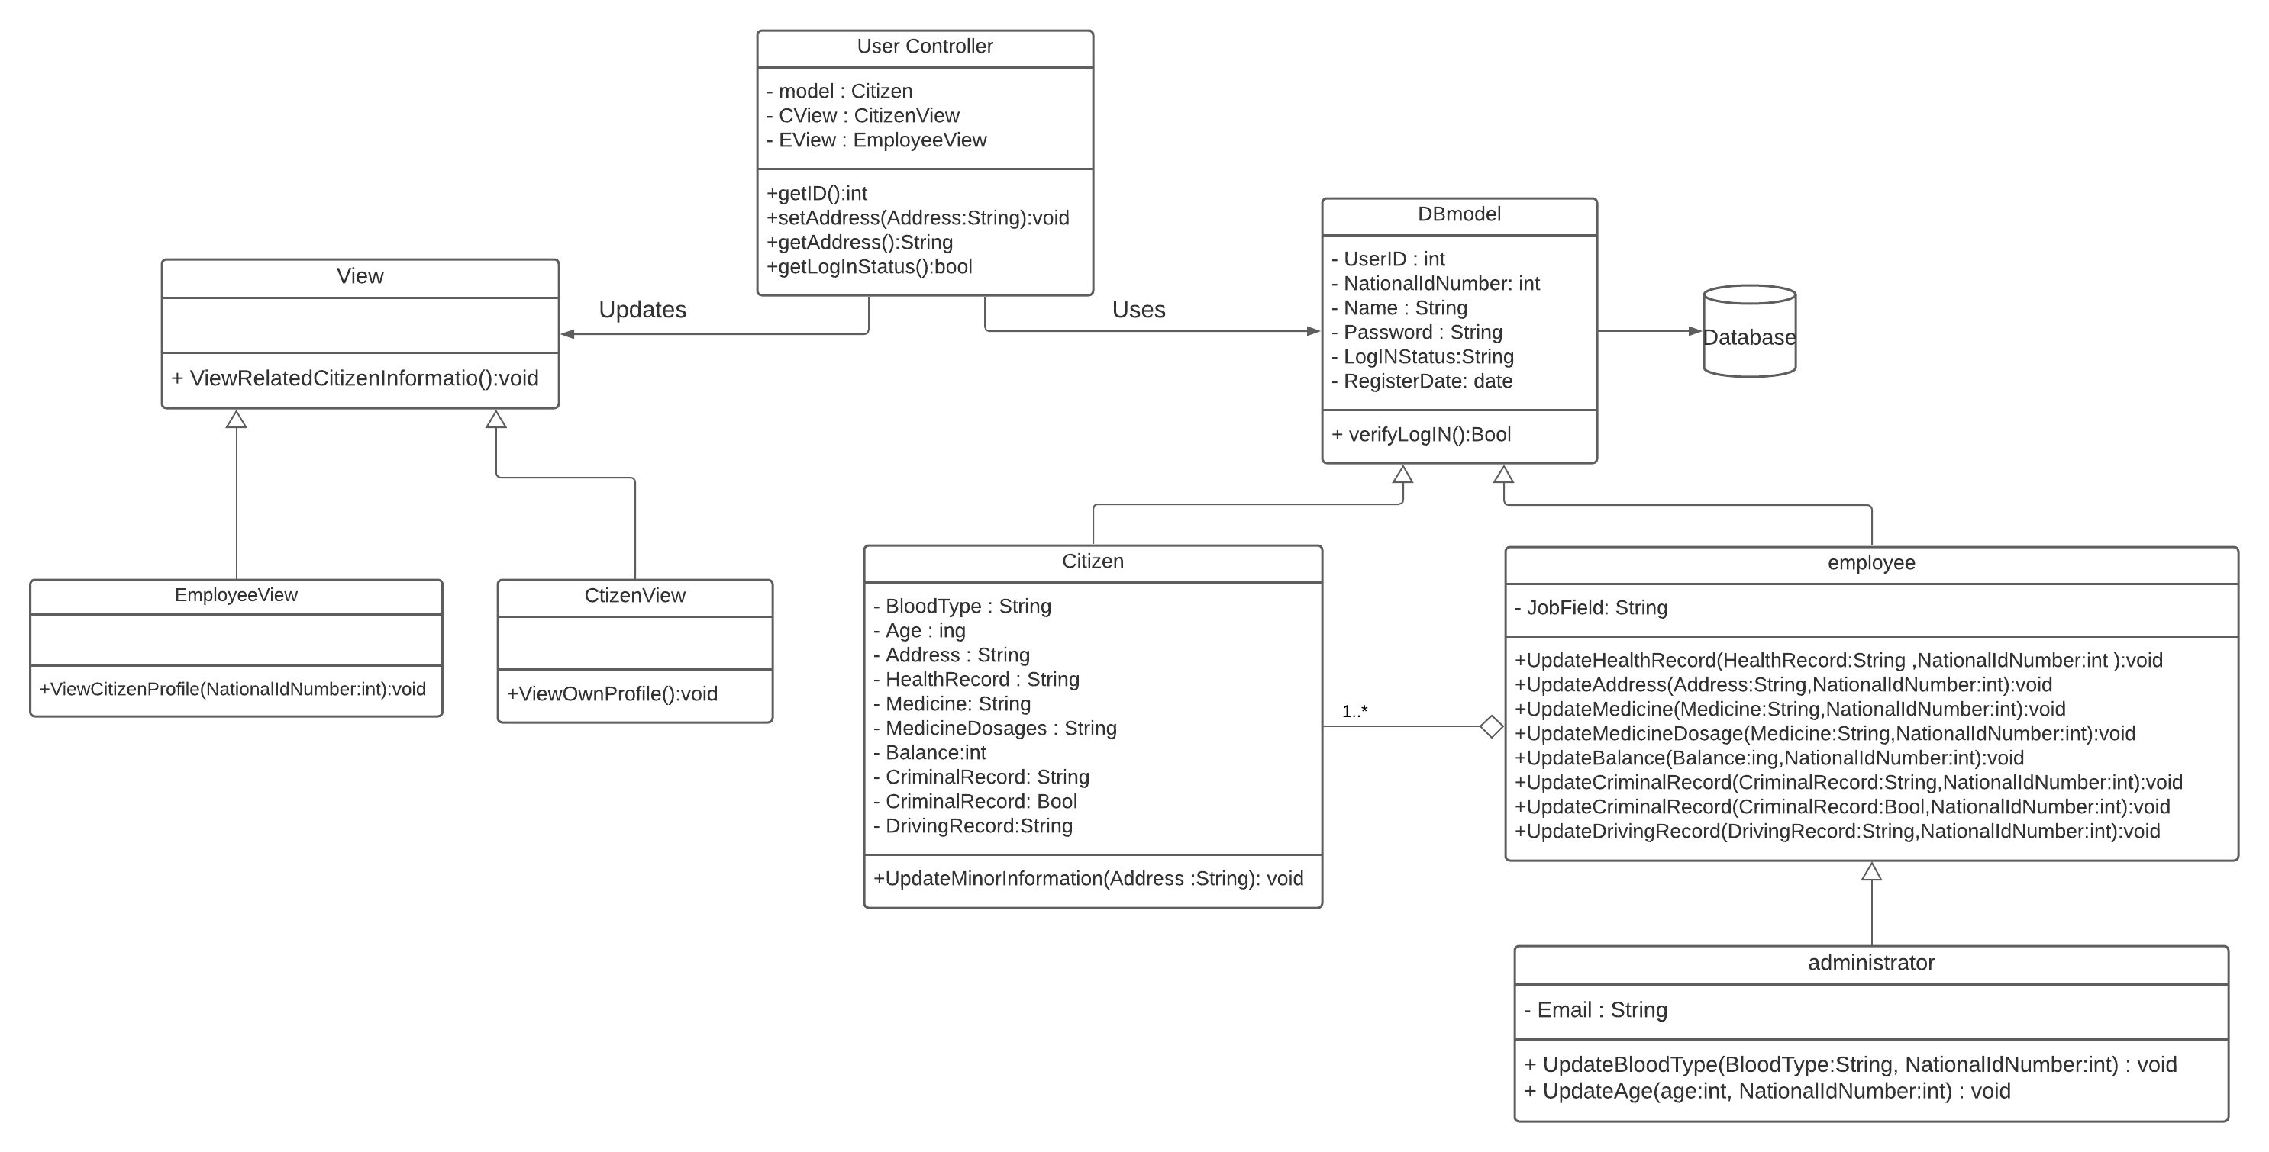
Class Diagram
Class Diagram

Slide 12
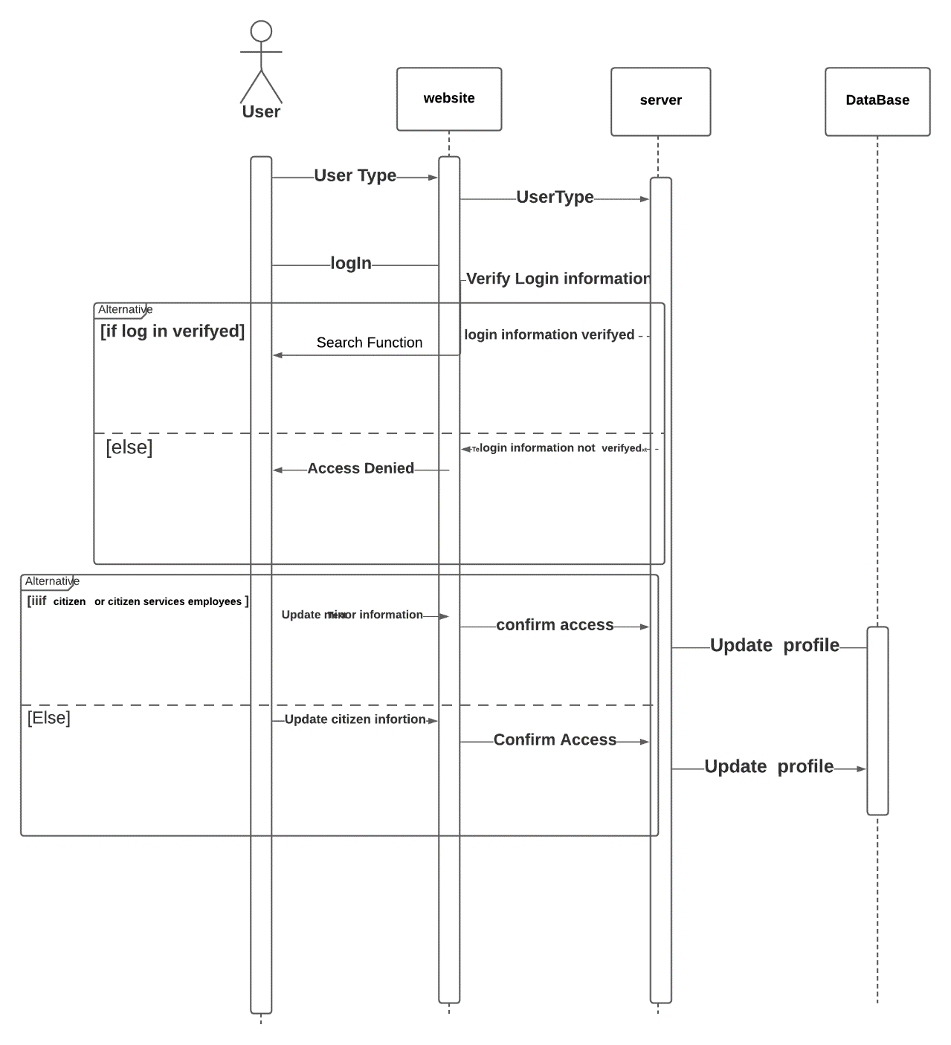
Sequence Diagram

Slide 13
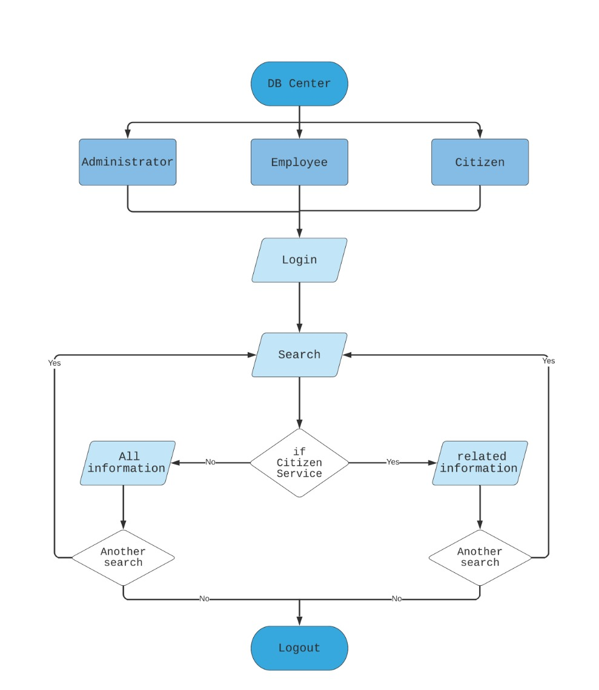
Flow Chart of the sysetm

Slide 14

Resutls

Slide 15
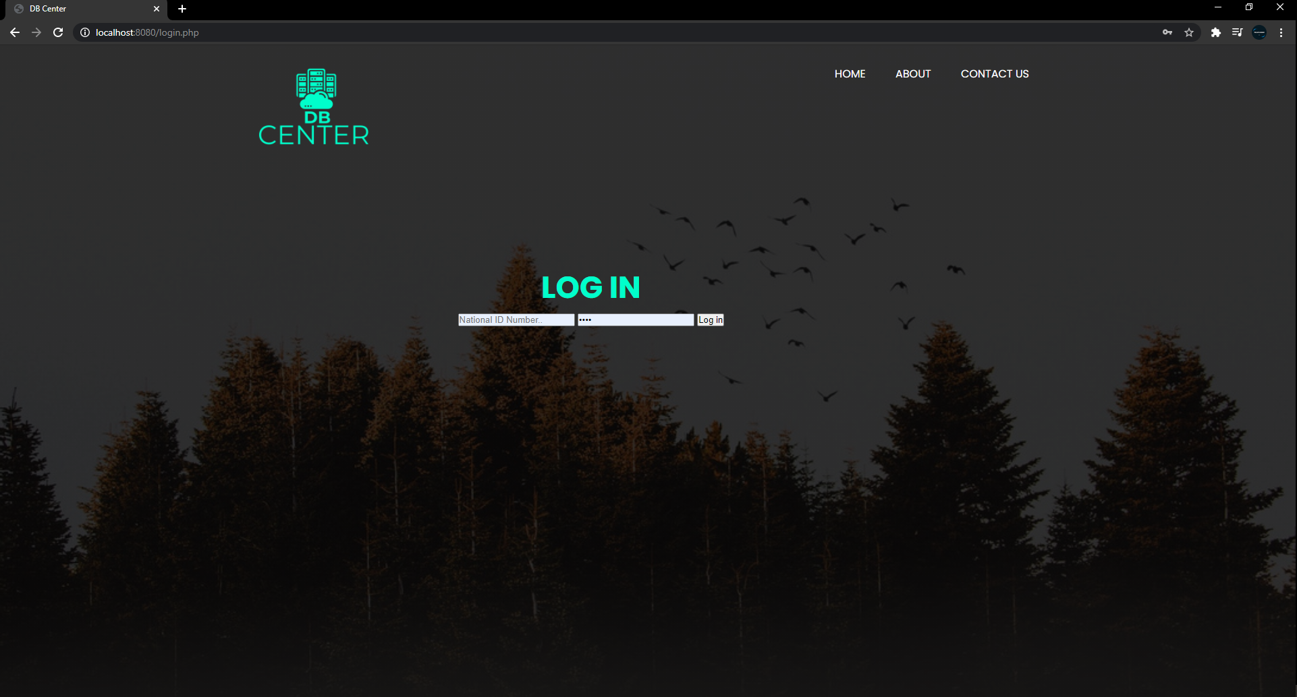
User Interface

Slide 16
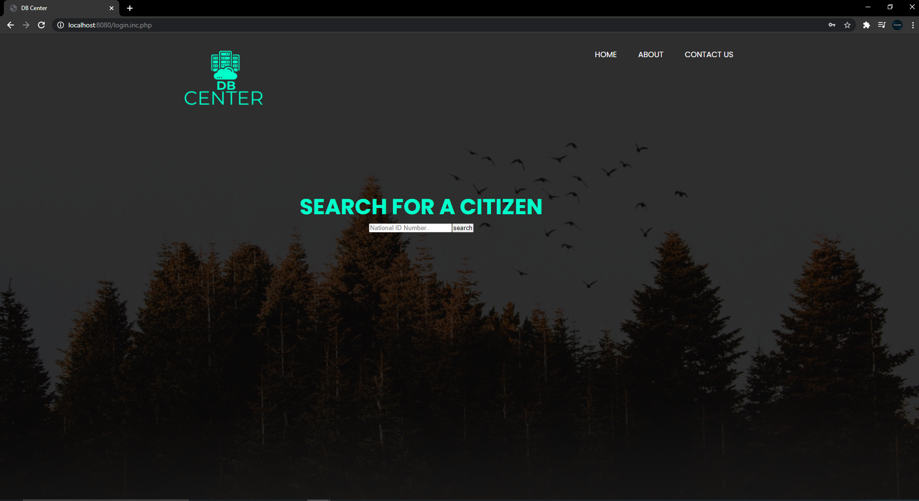

Slide 17
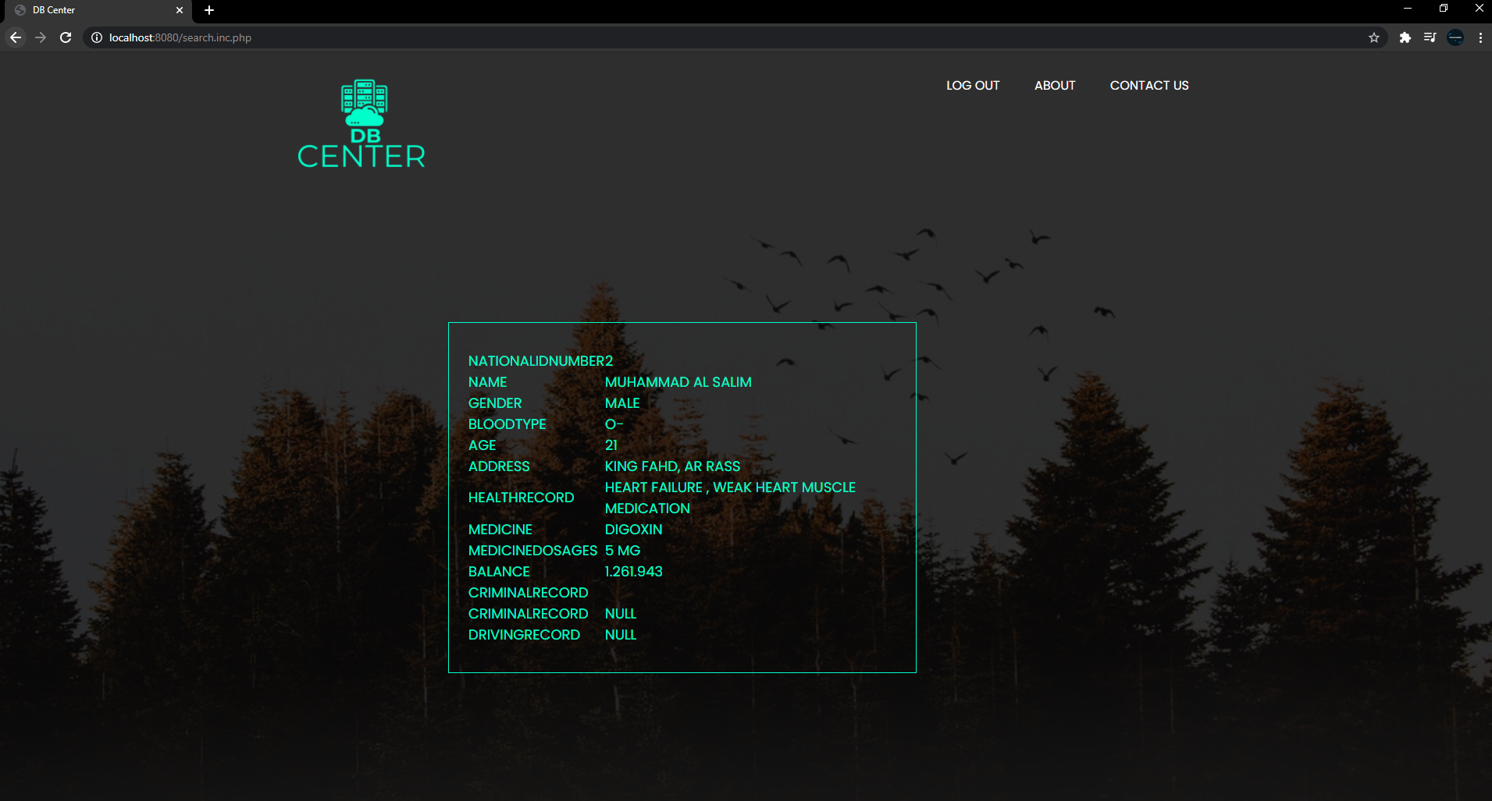

Slide 18

Source code

Slide 19
100%
80%
60%
40%
20%

Slide 20

Conclusion
We will continue to make the system better by improving the security and usability , we learned in the process of making this project

Slide 21

Any Questions?

